Slide 1
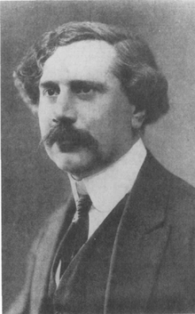

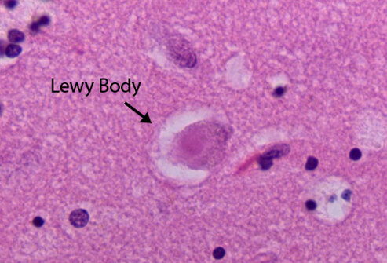
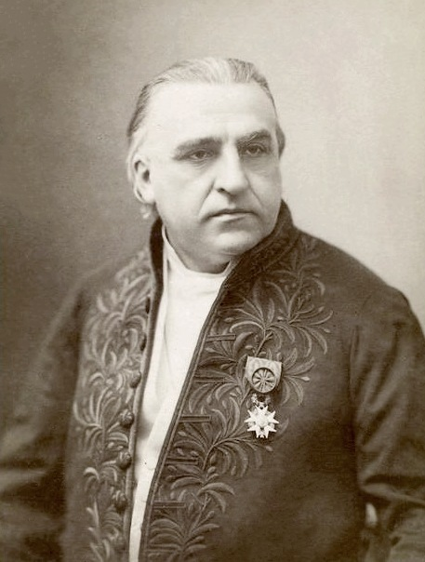
Milestones in Parkinson’s Disease Research and Discovery (Part 1a: Historical)
Compiled by Frank <https://journeywithparkinsons.com/> and Simon <https://scienceofparkinsons.com/>
Tretjakov reports the loss of cells in the substantia nigra
1919
Barger and Ewens synthesize dopamine
1912
Frederic Lewy found intracellular inclusions in affected brains
1910
William Gowers “Manual of Diseases of the Nervous System”
1888
James Parkinson’s essay
1861/2
Jean-Martin Charcot gives Parkinson’s disease it’s names
1817

Slide 2


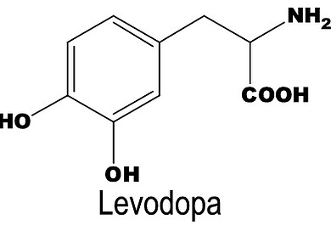


Milestones in Parkinson’s Disease Research and Discovery (Part 1b: Historical)
Compiled by Frank <https://journeywithparkinsons.com/> and Simon <https://scienceofparkinsons.com/>
Hoehn and Yahr- internationally-used staging system
1968
Hornykiewicz- dopamine in PD brains and Hornykiewicz & Birkmayer - 1st Levodopa trials
1967
Cotzias - perfects Levodopa
1960/1
Greenfield and Bosanquet- the complete PD pathologic analysis
1957
Parkinson's Disease Foundation
1957
Arvid Carlsson's dopamine studies
1953

Slide 3
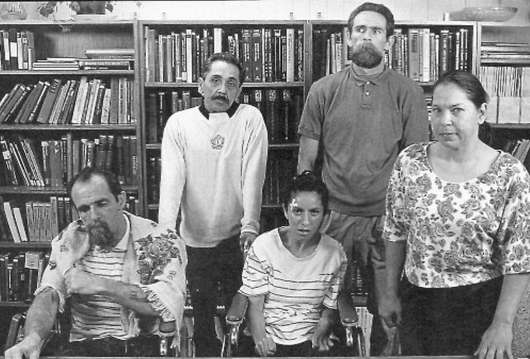
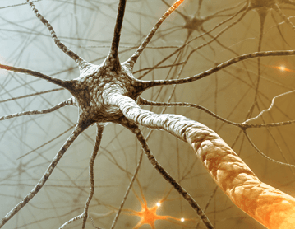
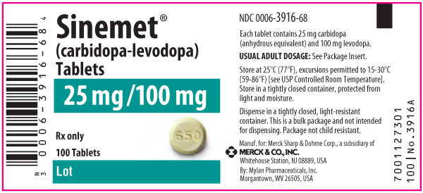
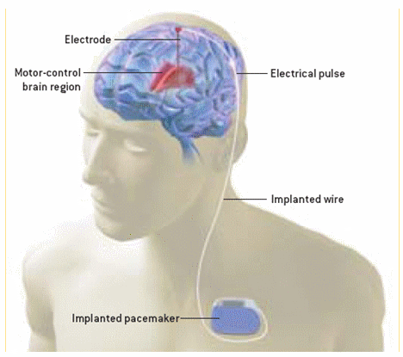
Milestones in Parkinson’s Disease Research and Discovery (Part 1c: Historical)
Compiled by Frank <https://journeywithparkinsons.com/> and Simon <https://scienceofparkinsons.com/>
1985
1997
1982
MPTP
Deep-brain stimulation (DBS) surgery
LSVT LOUD
Fetal Cell transplantation
1980’s
Levodopa + AADC inhibitors (carbidopa or benserazide)
Dopamine agonists
1977
1974
MAO-B inhibitors
1972

Slide 4
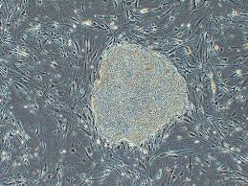
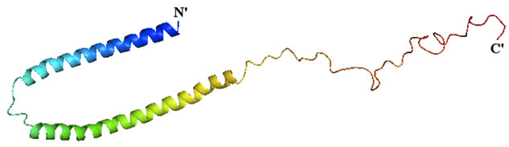

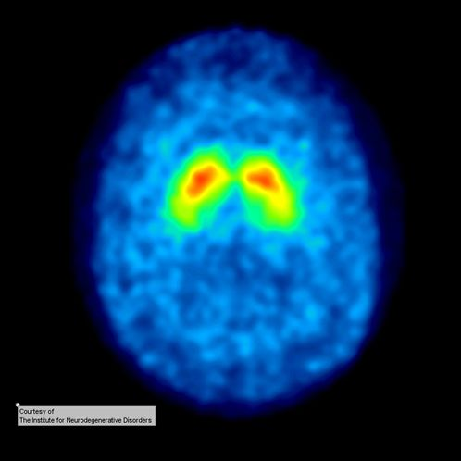
Milestones in Parkinson’s Disease Research and Discovery (Part 1d: Historical)
Compiled by Frank <https://journeywithparkinsons.com/> and Simon <https://scienceofparkinsons.com/>
Induced pluri-
potent stem
cells from
skin cells
Braak Staging of Parkinson’s pathology;
DJ1 linked to early onset PD
GDNF trial suggests neuroprotection
2006
2004
Pink1 and LRRK2 associated with early onset PD
2003
2000
Launch of MJFox
Foundation
Alpha synuclein associated with familial cases of PD and in Lewy bodies
1999
PET scan brain
imaging
1998
1997
Parkin gene associated with juvenile PD

Slide 5

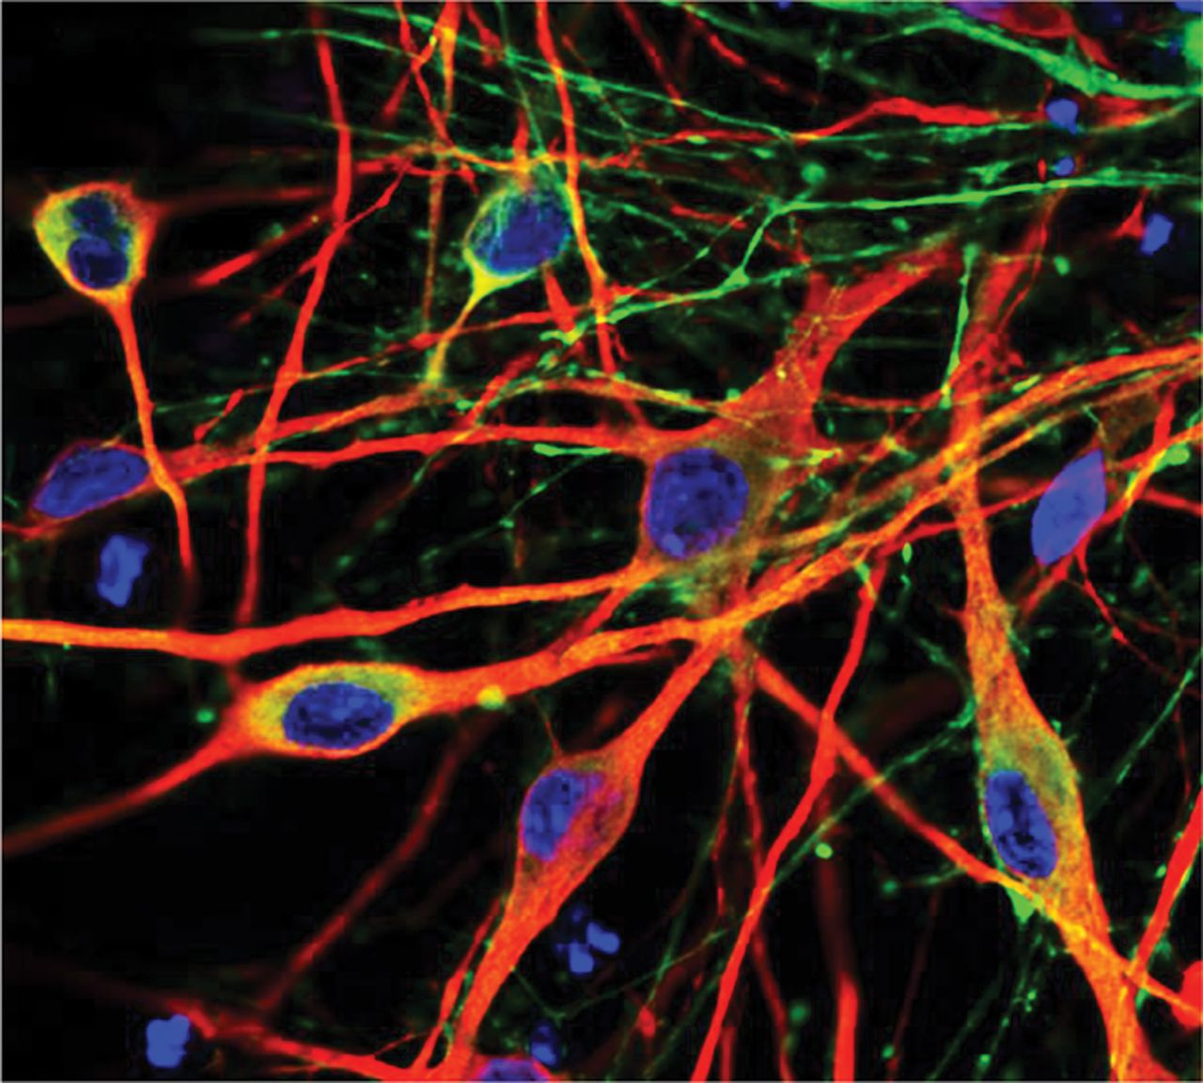

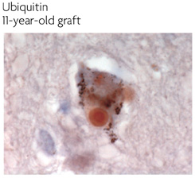
Milestones in Parkinson’s Disease Research and Discovery (Part 1e: Historical)
Compiled by Frank <https://journeywithparkinsons.com/> and Simon <https://scienceofparkinsons.com/>
Successful preclinical testing of dopamine neurons from embryonic stem cells
2016
Transeuro cell transplantation trial begins
Microbiome of the gut influences PD
2014
Neuroprotective effect of exercise in rodent PD models
2010
2010
SNCA, MAPT and LRRK2 are risk genes for idiopathic PD
IPS derived dopamine neurons from people with PD
2009
2008
MDS-UPDRS revised rating scale
Lewy bodies found in transplanted cells
2007

Slide 6
Milestones in Parkinson’s Disease Research and Discovery (Part 2: Clinical trials either recently completed or in progress)
Compiled by Frank <https://journeywithparkinsons.com/> and Simon <https://scienceofparkinsons.com/>
Treatment of Parkinson’s Psychosis with Nuplazid
Opicapone (COMT Inhibitor) as Adjunct to Levodopa Therapy
mGluR4 PAM (PXT002331) well tolerated in phase I trial
Initial results of Bristol GDNF trial indicate no effect
MAO-B inhibitors shown to be neuroprotective.
Inhalable form of L-dopa
Exenatide trial results expected
2016
2016
2017
2016
Safety, Tolerability and Efficacy Assessment of Dynacirc (Isradipine) for PD (STEADY-PD) III trial
2016
Nilotinib (Tasigna® by Novartis) indicates positive results in phase I trial.
ISCO cell transplantation trial begins
Neuropore's alpha-synuclein stabilizer (NPT200-11) passes phase I trial
2017
Immunotherapies proves safe in phase I trials (Affiris & Prothena)
Living Cell Technologies Limited continue Phase II trial of NTCELL

